Slide 1

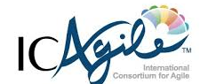
Chapter 3: Kubernetes Installation and Architecture
Agile Brains Consulting
1
©Agile Brains Consulting Inc. All rights reserved. Not to be reproduced without prior written consent.

Slide 2
Architecture – Bird’s Eye View
Cluster Management / Orchestration Engine
(Provisioning, Config Management, Packaging, OS patches, logging, monitoring)
Cluster 3
Cluster 4
Application
Application
Application
Cluster 1
Cluster 2
Application
Application
Application
vm
vm
vm
vm
vm
vm
vm
vm
Physical Infrastructure
Agile Brains Consulting
2
©Agile Brains Consulting Inc. All rights reserved. Not to be reproduced without prior written consent.

Slide 3
What is Kubernetes?
Kubernetes is inspired from an internal Google project called Borg
Open source project managed by the Linux Foundation
Unified API for deploying web applications, batch jobs, and databases
Decouples applications from machines through containers
Declarative approach to deploying applications
Automates application configuration through service discovery
Maintains and tracks the global view of the cluster
APIs for deployment workflows
Rolling updates, canary deploys, and blue-green deployments
Agile Brains Consulting
3
©Agile Brains Consulting Inc. All rights reserved. Not to be reproduced without prior written consent.

Slide 4
Kubernetes Architecture (Bird’s eye view)
Yaml/Json
config file
Kubernetes Master
API
Node 1
Node 2
UI
Node 3
CLI
Node n
Registry
Agile Brains Consulting
4
©Agile Brains Consulting Inc. All rights reserved. Not to be reproduced without prior written consent.

Slide 5
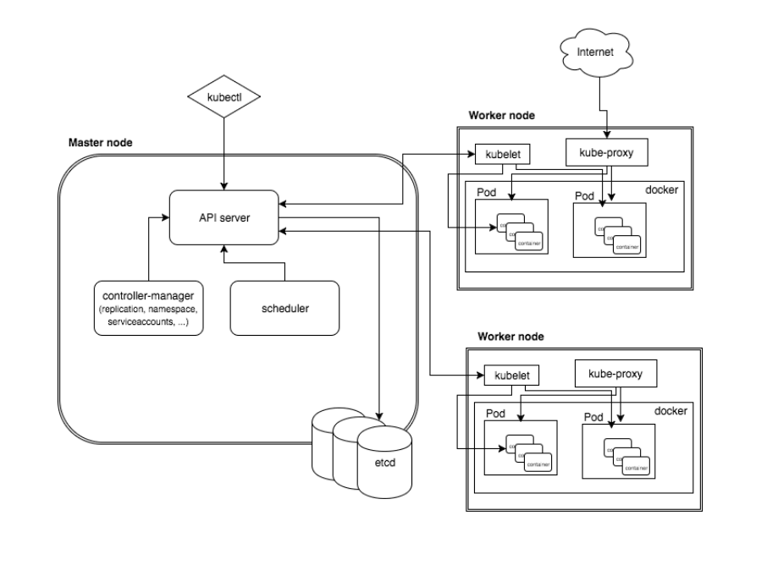
K8s Architecture – detailed
Agile Brains Consulting
5
©Agile Brains Consulting Inc. All rights reserved. Not to be reproduced without prior written consent.

Slide 6
Install Kubernetes on AWS using KubeAdm
Agile Brains Consulting
6
©Agile Brains Consulting Inc. All rights reserved. Not to be reproduced without prior written consent.

Slide 7
Lab: AWS Single node cluster installation using KubeAdm
** Master node need to have at least 2 CPUs
https://github.com/shekhar2010us/kubernetes_teach_git/blob/master/kubernetes_single_node_cluster_installation.md
** Do this lab the first thing – so that we all have machines with Docker which will be used to run exercises in lab 1
** Instructions for installing multi-node k8s cluster is provided in the above link
Agile Brains Consulting
7
©Agile Brains Consulting Inc. All rights reserved. Not to be reproduced without prior written consent.

Slide 8
Kubectl
Agile Brains Consulting
8
©Agile Brains Consulting Inc. All rights reserved. Not to be reproduced without prior written consent.

Slide 9
Kubectl
kubectl is Kubernetes command-line tool for running commands against Kubernetes clusters.
It can be used to deploy and manage applications on Kubernetes.
Using kubectl, you can inspect cluster resources; create, delete, and update components; look at your new cluster; and bring up example apps etc.
Agile Brains Consulting
9
©Agile Brains Consulting Inc. All rights reserved. Not to be reproduced without prior written consent.

Slide 10
Kubectl – Installation
https://kubernetes.io/docs/tasks/tools/install-kubectl/
On Ubuntu/Debian
sudo apt-get update && sudo apt-get install -y apt-transport-https
curl -s https://packages.cloud.google.com/apt/doc/apt-key.gpg | sudo apt-key add -
echo "deb https://apt.kubernetes.io/ kubernetes-xenial main" | sudo tee -a /etc/apt/sources.list.d/kubernetes.list
sudo apt-get update
sudo apt-get install -y kubectl
To check installation (execute):
kubectl version
** Note: We have already done it while K8s installation
Agile Brains Consulting
10
©Agile Brains Consulting Inc. All rights reserved. Not to be reproduced without prior written consent.

Slide 11
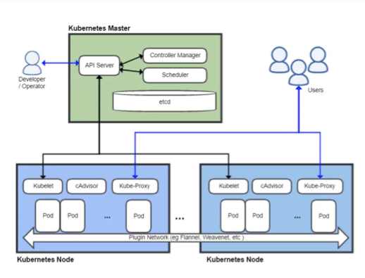
Master and Worker Nodes
Agile Brains Consulting
11
©Agile Brains Consulting Inc. All rights reserved. Not to be reproduced without prior written consent.

Slide 12
Kubernetes: Any Node
Any kubernetes node status contains:
Addresses
Hostname
External IP
Internal IP
Condition - describe condition of nodes – OutOfDisk, Ready, MemoryPressure, DiskPressure, NetworkUnavailable
Capacity - describe the resources available on the nods – CPU, memory, maximum number of pods that can be scheduled onto the node
Info – general information about the node – kernel version, Kubernetes version, kubelet and kube-proxy version, Docker version, OS name
Command to get node details:
kubectl describe nodes <node_name>
Agile Brains Consulting
12
©Agile Brains Consulting Inc. All rights reserved. Not to be reproduced without prior written consent.

Slide 13
Master Node
Agile Brains Consulting
13
©Agile Brains Consulting Inc. All rights reserved. Not to be reproduced without prior written consent.

Slide 14
Master Node Role
Master components provide the cluster’s control plane. Master components make global decisions about the cluster (for example, scheduling), and detecting and responding to cluster events (starting up a new pod when a replication controller’s ‘replicas’ field is unsatisfied).
Master components can be run on any machine in the cluster. However, for simplicity, set up scripts typically start all master components on the same machine, and do not run user containers on this machine.
Agile Brains Consulting
14
©Agile Brains Consulting Inc. All rights reserved. Not to be reproduced without prior written consent.

Slide 15
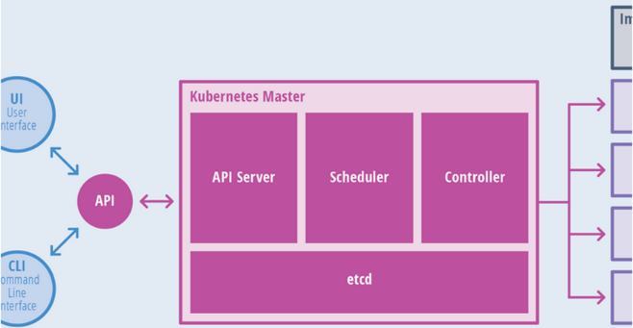
Master Node Components
Components of master:
API Server
Scheduler
Controller
etcd
Agile Brains Consulting
15
©Agile Brains Consulting Inc. All rights reserved. Not to be reproduced without prior written consent.

Slide 16
Master Node Components
The API server is the entry points for all the REST commands used to control the cluster. It processes REST requests, validates them, and executes the bound business logic. The result state has to be persisted in the “etcd” component.
Etcd is an open source, distributed key-value database; it acts as a single source of truth (SSOT) for all components of the Kubernetes cluster. Masters query etcd to retrieve various parameters of the state of the nodes, pods and containers. Etcd is considered a metadata service in Kubernetes.
Agile Brains Consulting
16
©Agile Brains Consulting Inc. All rights reserved. Not to be reproduced without prior written consent.

Slide 17
Master Node Components
Controller Manager is responsible for most of the collectors that regulate the state of the cluster. In general, a controller can be considered a daemon that runs in nonterminating loop and is responsible for collecting and sending information to the API server. It works toward getting the shared state of cluster and then making changes to bring the current status of the server to the desired state. The key controllers are replication controller, endpoint controller, namespace controller, and service account controller. The controller manager runs different kind of controllers to handle nodes, endpoints, etc.
Scheduler is one of the key components of Kubernetes master. It is responsible for distributing the workload, tracking resource utilization on cluster nodes and selecting the nodes for the workloads to run. In other words, this is the mechanism responsible for allocating pods to available nodes.
Agile Brains Consulting
17
©Agile Brains Consulting Inc. All rights reserved. Not to be reproduced without prior written consent.

Slide 18
Worker Node
Agile Brains Consulting
18
©Agile Brains Consulting Inc. All rights reserved. Not to be reproduced without prior written consent.

Slide 19
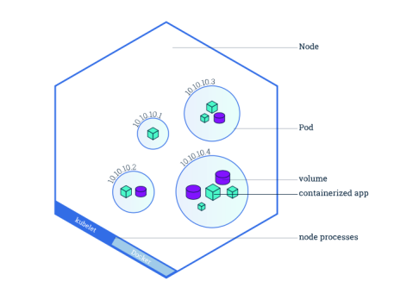
Worker Node Roles
A node is a worker machine in Kubernetes. A node may be a VM or physical machine, depending on the cluster. Each node has the services necessary to run pods and is managed by the master components. The services on a node include Docker, kubelet and kube-proxy.
Allows Pods to be scheduled. A basic worker physical or virtual machine of Kubernetes.
Must be managed by a master
May host multiple pods
Internal IP Address endpoint
Can be tagged and filtered using labels
Agile Brains Consulting
19
©Agile Brains Consulting Inc. All rights reserved. Not to be reproduced without prior written consent.

Slide 20
Worker Node Components
kubelet Service interacts with etcd store to read configuration details and to write values via api-server. It communicates with the master component to receive commands and work. The kubelet process then assumes responsibility for maintaining the state of work and the node server. It manages network rules, port forwarding, etc.
kubelet takes a set of PodSpecs that are provided through various mechanisms and ensures that the containers described in those PodSpecs are running and healthy. The kubelet doesn’t manage containers which were not created by Kubernetes.
Agile Brains Consulting
20
©Agile Brains Consulting Inc. All rights reserved. Not to be reproduced without prior written consent.

Slide 21
Worker Node Components
kube-proxy enables the Kubernetes service abstraction by maintaining network rules on the host and performing connection forwarding.
Kubernetes Proxy Service is a proxy service which runs on each node and helps in making services available to the external host. It helps in forwarding the request to correct containers and is capable of performing primitive load balancing. It makes sure that the networking environment is predictable and accessible and at the same time it is isolated as well. It manages pods on node, volumes, secrets, creating new containers’ health checkup, etc.
Agile Brains Consulting
21
©Agile Brains Consulting Inc. All rights reserved. Not to be reproduced without prior written consent.

Slide 22
Cloud Controller Manager
Agile Brains Consulting
22
©Agile Brains Consulting Inc. All rights reserved. Not to be reproduced without prior written consent.

Slide 23
Cloud Controller Manager (CCM)
Initially part of kube-controller-manager
CCM was created to allow cloud vendor code and k8s core to evolve independent of one another
Runs along other master components
Can also be started as a Kubernetes add-on, in which case it runs on top of Kubernetes
Design is based on a plugin mechanism
Agile Brains Consulting
23
©Agile Brains Consulting Inc. All rights reserved. Not to be reproduced without prior written consent.
Notes:
https://kubernetes.io/docs/concepts/architecture/cloud-controller/

Slide 24
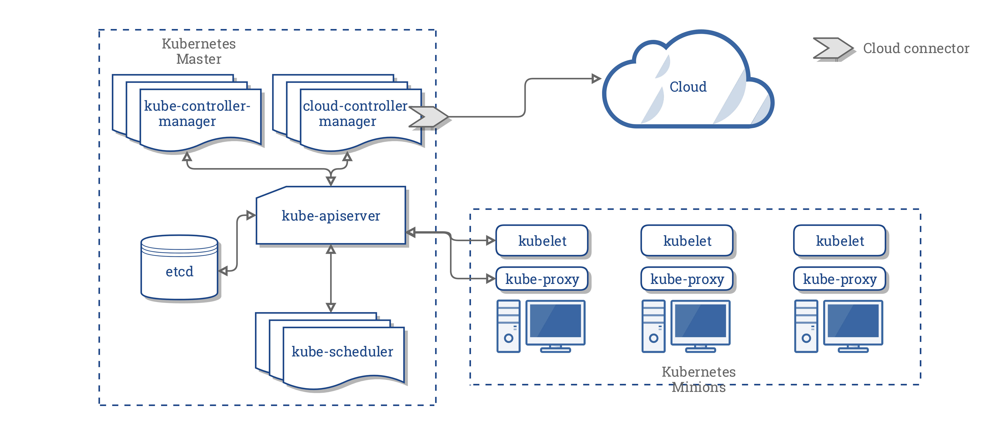
Cloud Controller Manager (CCM)
Agile Brains Consulting
24
©Agile Brains Consulting Inc. All rights reserved. Not to be reproduced without prior written consent.
Notes:
https://kubernetes.io/docs/concepts/architecture/cloud-controller/

Slide 25
Running Cloud Controllers
Infrastructure requirements
cloud authentication/authorization
kubernetes authentication/authorization
high availability
Configuration changes
kube-apiserver and kube-controller-manager MUST NOT specify the --cloud-provider flag
kubelet must run with --cloud-provider=external
Agile Brains Consulting
25
©Agile Brains Consulting Inc. All rights reserved. Not to be reproduced without prior written consent.

Slide 26
Example Cloud Controllers
Cloud vendors
Digital Ocean, OCI, Rancher
Examples of CCM
Node Controller: For checking the cloud provider to determine if a node has been deleted in the cloud after it stops responding
Route Controller: For setting up routes in the underlying cloud infrastructure
Service Controller: For creating, updating and deleting cloud provider load balancers
PersistentVolumeLabels controller: It applies labels on AWS EBS/GCE PD volumes when they are created. This removes the need for users to manually set the labels on these volumes.
Agile Brains Consulting
26
©Agile Brains Consulting Inc. All rights reserved. Not to be reproduced without prior written consent.

Slide 27
Part 2
Kubernetes Dashboard

Slide 28
Lab: Dashboard Setup
https://github.com/shekhar2010us/kubernetes_teach_git/blob/master/kubernetes_dashboard_installation.md
Agile Brains Consulting
28
©Agile Brains Consulting Inc. All rights reserved. Not to be reproduced without prior written consent.

Slide 29
Part 3
Kubernetes Authentication and Access Control

Slide 30
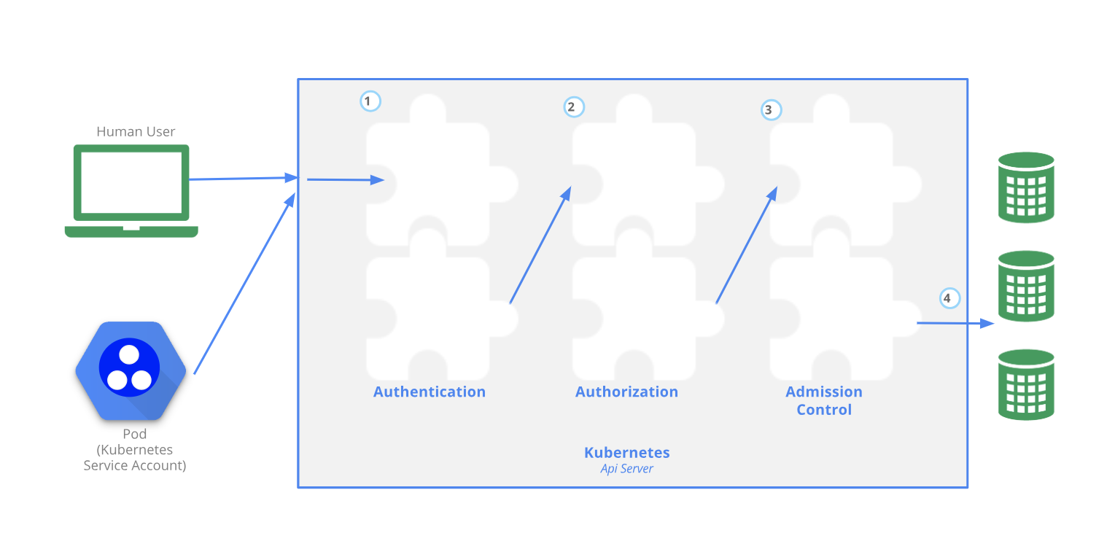
Control Access to APIs
Human users and K8s service accounts can be authorized for API access.
When a request reaches the API, it goes through 3 stages.
Authentication
Authorization
Admission Control
Agile Brains Consulting
30
©Agile Brains Consulting Inc. All rights reserved. Not to be reproduced without prior written consent.

Slide 31
Step 1: Authentication
HTTP request is passed to the authenticator to authenticate the user.
Type of authenticator (set by cluster admin):
client certificate ($USER/.kube/config contains root certificate for api-server certificate)
password
plain token
bootstrap token
* If the admin sets multiple, this step checks all and grants access even if one is passed.
Status:
pass: the user is authenticated as "username", and this "username" is available to subsequent steps.
fail: 401 code
Agile Brains Consulting
31
©Agile Brains Consulting Inc. All rights reserved. Not to be reproduced without prior written consent.

Slide 32
Step 2: Authorization
After successful authentication, the HTTP request is authorized for existing "policies"
HTTP request contains {"username", "requested action", "objects getting affected"}
Type of authorizers (set by cluster admin):
RBAC – Role based access control
ABAC – Attribute based access control
RBAC and ABAC allows the cluster-admin to dynamically configure policies through the Kubernetes API to grant restricted access.
* If the admin sets multiple, this step checks all and grants access even if one is passed.
Agile Brains Consulting
32
©Agile Brains Consulting Inc. All rights reserved. Not to be reproduced without prior written consent.

Slide 33
RBAC (Role based Access Control)
Role – are additive rules with set of permissions. (no "deny" rules)
API group: rbac.authorization.k8s.io
Enable api-server with: --authorization-mode=RBAC
Type of Roles:
Role – within a namespace
ClusterRole – within the cluster
Agile Brains Consulting
33
©Agile Brains Consulting Inc. All rights reserved. Not to be reproduced without prior written consent.

Slide 34
Role
# role for accessing pods in default namespace
kind: Role apiVersion: rbac.authorization.k8s.io/v1 metadata: namespace: default name: pod-reader rules: - apiGroups: [""] # "" is core API group resources: ["pods"] verbs: ["get", "watch", "list"]
# role using resourceNames
rules: - apiGroups: [""] resources: ["configmaps"]
resourceNames: ["my-configmap"] verbs: ["update", "get"]
# role for a non-resource endpoint
rules: - nonResourceURLs: ["/healthz", "/healthz/*"] verbs: ["get", "post"]
# The above role won't be able to access pod logs # {pod = namespaced resource}, {logs = is not}
rules: - apiGroups: [""] resources: ["pods", "pods/log"] verbs: ["get", "list"]
Agile Brains Consulting
34
©Agile Brains Consulting Inc. All rights reserved. Not to be reproduced without prior written consent.

Slide 35
RoleBinding
RoleBinding – refer subjects (users, groups, or service accounts) to a role
# A role binding allows "Mary" to read
# pods in the "default" namespace kind: RoleBinding apiVersion: rbac.authorization.k8s.io/v1 metadata: name: read-pods namespace: default subjects: - kind: User name: Mary # case sensitive apiGroup: rbac.authorization.k8s.io roleRef: kind: Role name: pod-reader apiGroup: rbac.authorization.k8s.io
# binding for a group subjects: - kind: Group name: "frontend-admins"
# default service account in the kube-system namespace subjects: - kind: ServiceAccount name: default namespace: kube-system
# binding for all service accounts in the "qa" namespace subjects: - kind: Group name: system:serviceaccounts:qa
Agile Brains Consulting
35
©Agile Brains Consulting Inc. All rights reserved. Not to be reproduced without prior written consent.

Slide 36
Question – why need namespace for a RoleBinding when it is already scoped and defined in a Role?
Answer – A RoleBinding may also refer a ClusterRole to grant the permissions to namespaced resources defined in the ClusterRole within the RoleBinding’s namespace.
E.g. for a ClusterRole that reads secrets in all namespace, if you define a RoleBinding (with namespace=n1) referring to the ClusterRole, the user will read secrets in the namespace=n1 only not in all namespace (which was the scope of ClusterRole)
Agile Brains Consulting
36
©Agile Brains Consulting Inc. All rights reserved. Not to be reproduced without prior written consent.

Slide 37
ClusterRole
ClusterRole = Roles defined for the entire cluster
ClusterRole = Role + cluster resources (like nodes) + non-resource (like /healtz) + not limited to one namespace
# ClusterRole to read secrets across all namespace
kind: ClusterRole apiVersion: rbac.authorization.k8s.io/v1 metadata: # no "namespace”, ClusterRoles are not namespaced name: secret-reader rules: - apiGroups: [""] resources: ["secrets"] verbs: ["get", "watch", "list"]
Agile Brains Consulting
37
©Agile Brains Consulting Inc. All rights reserved. Not to be reproduced without prior written consent.

Slide 38
ClusterRole Binding
ClusterRoleBinding – refer subjects (users, groups, or service accounts) to a ClusterRole
# This cluster role binding allows anyone in the "manager" group to read secrets in any namespace. kind: ClusterRoleBinding apiVersion: rbac.authorization.k8s.io/v1 metadata: name: read-secrets-global subjects: - kind: Group name: manager # Name is case sensitive apiGroup: rbac.authorization.k8s.io roleRef: kind: ClusterRole name: secret-reader apiGroup: rbac.authorization.k8s.io
Agile Brains Consulting
38
©Agile Brains Consulting Inc. All rights reserved. Not to be reproduced without prior written consent.

Slide 39
ABAC (Attribute based Access Control)
Defines an access control paradigm whereby access rights are granted to users through the
use of policies which combine attributes together
API group: abac.authorization.k8s.io
Enable api-server with: --authorization-mode=ABAC
Provide api-server with access file: --authorization-policy-file=SOME_FILENAME
Each line in the policy file is the policy JSON object
Agile Brains Consulting
39
©Agile Brains Consulting Inc. All rights reserved. Not to be reproduced without prior written consent.

Slide 40
ABAC Policies
# John has read-only access to pods in 'developer' namespace
{ "apiVersion": "abac.authorization.kubernetes.io/v1beta1", "kind": "Policy", "spec": { "user": "john200", "namespace": "developer", "resource": "pods", "readonly": true } }
ServiceAccount: is identified by "system:serviceaccount:<namespace>:<serviceaccountname>"
# default service account (in the kube-system namespace) full privilege to the API
{ "apiVersion": "abac.authorization.kubernetes.io/v1beta1", "kind": "Policy", "spec": { "user": "system:serviceaccount:kube-system:default", "namespace": "*", "resource": "*", "apiGroup": "*" } }
Agile Brains Consulting
40
©Agile Brains Consulting Inc. All rights reserved. Not to be reproduced without prior written consent.

Slide 41
Step 3: Admission Control
Checks if the user requesting for a write operation has the necessary permission to bring the change in the K8s resource. Thus, happens prior to persistence of the object.
Enable: kube-apiserver --enable-admission-plugins=NamespaceLifecycle,LimitRanger
Plugins enabled by default: NamespaceLifecycle, LimitRanger, ServiceAccount, PersistentVolumeClaimResize, DefaultStorageClass, DefaultTolerationSeconds, MutatingAdmissionWebhook, ValidatingAdmissionWebhook, ResourceQuota, Priority
* Many advanced features in Kubernetes require an admission controller to be enabled in order to properly support the feature.
Agile Brains Consulting
41
©Agile Brains Consulting Inc. All rights reserved. Not to be reproduced without prior written consent.

Slide 42
Service Accounts
-- Provides an identity for processes that runs in a Pod
Human users are authenticated by the api-server as a particular User account.
Processes in containers inside pods are authenticated by the api-server as a particular Service account.
When a pod is created;
spec.serviceAccountName mentions the ServiceAccount, "default" is auto assigned.
The API permissions of the service account is defined in the authorization policy (RBAC or ABAC) as discussed earlier.
Good practice: Grant a role to an application-specific service account
Agile Brains Consulting
42
©Agile Brains Consulting Inc. All rights reserved. Not to be reproduced without prior written consent.

Slide 43
Service Accounts – Resource
# create a service account named acc1 apiVersion: v1 kind: ServiceAccount metadata: name: acc1
auto-create token
secrets: - name: acc1-token-bvbk5
# manually created token and use for a service account
apiVersion: v1 kind: Secret metadata: name: acc1-secret annotations: kubernetes.io/service-account.name: acc1 type: kubernetes.io/service-account-token
# create a pod using acc1 service account apiVersion: v1 kind: Pod metadata: name: my-pod spec: serviceAccountName: acc1
Agile Brains Consulting
43
©Agile Brains Consulting Inc. All rights reserved. Not to be reproduced without prior written consent.

Slide 44
Service Accounts – ImagePullSecret
Case: Limited access to multiple docker registries
Create a ImagePullSecret
$ kubectl create secret docker-registry myregistrykey --docker-server=DOCKER_REGISTRY_SERVER --docker-username=DOCKER_USER --docker-password=DOCKER_PASSWORD --docker-email=DOCKER_EMAIL
Change the service account to use the above ImagePullSecret
$ kubectl patch serviceaccount default -p '{"imagePullSecrets": [{"name": "myregistrykey"}]}’
* Now the pod using the serviceaccount “default” will use the secret to pull images from the specific docker registry
Agile Brains Consulting
44
©Agile Brains Consulting Inc. All rights reserved. Not to be reproduced without prior written consent.

Slide 45
Service Accounts – Pod creation
Case: What happens with ServiceAccount when a Pod is created
If the pod does not have a ServiceAccount set, it sets the ServiceAccount to default.
It ensures that the ServiceAccount referenced by the pod exists, and otherwise rejects it.
If the pod does not contain any ImagePullSecrets, then ImagePullSecrets of the ServiceAccount are added to the pod.
It adds a volume to the pod which contains a token for API access.
It adds a volumeSource to each container of the pod mounted at /var/run/secrets/kubernetes.io/serviceaccount
Agile Brains Consulting
45
©Agile Brains Consulting Inc. All rights reserved. Not to be reproduced without prior written consent.

Slide 46
Service Accounts – apiserver access from pod
Case: Accessing api-server from a pod (use ServiceAccount token)
Place the serviceaccount token in the containers of the pod in the path - /var/run/secrets/kubernetes.io/serviceaccount/token
Run "kubectl proxy"
kubectl proxy
- Creates a proxy server or application-level gateway between localhost and the Kubernetes API Server.
Agile Brains Consulting
46
©Agile Brains Consulting Inc. All rights reserved. Not to be reproduced without prior written consent.

